Slide 1
Northwoods Fire Strategy Spatial Exploration
Where bad fires might occur, and where should we take action to prevent them

Slide 2
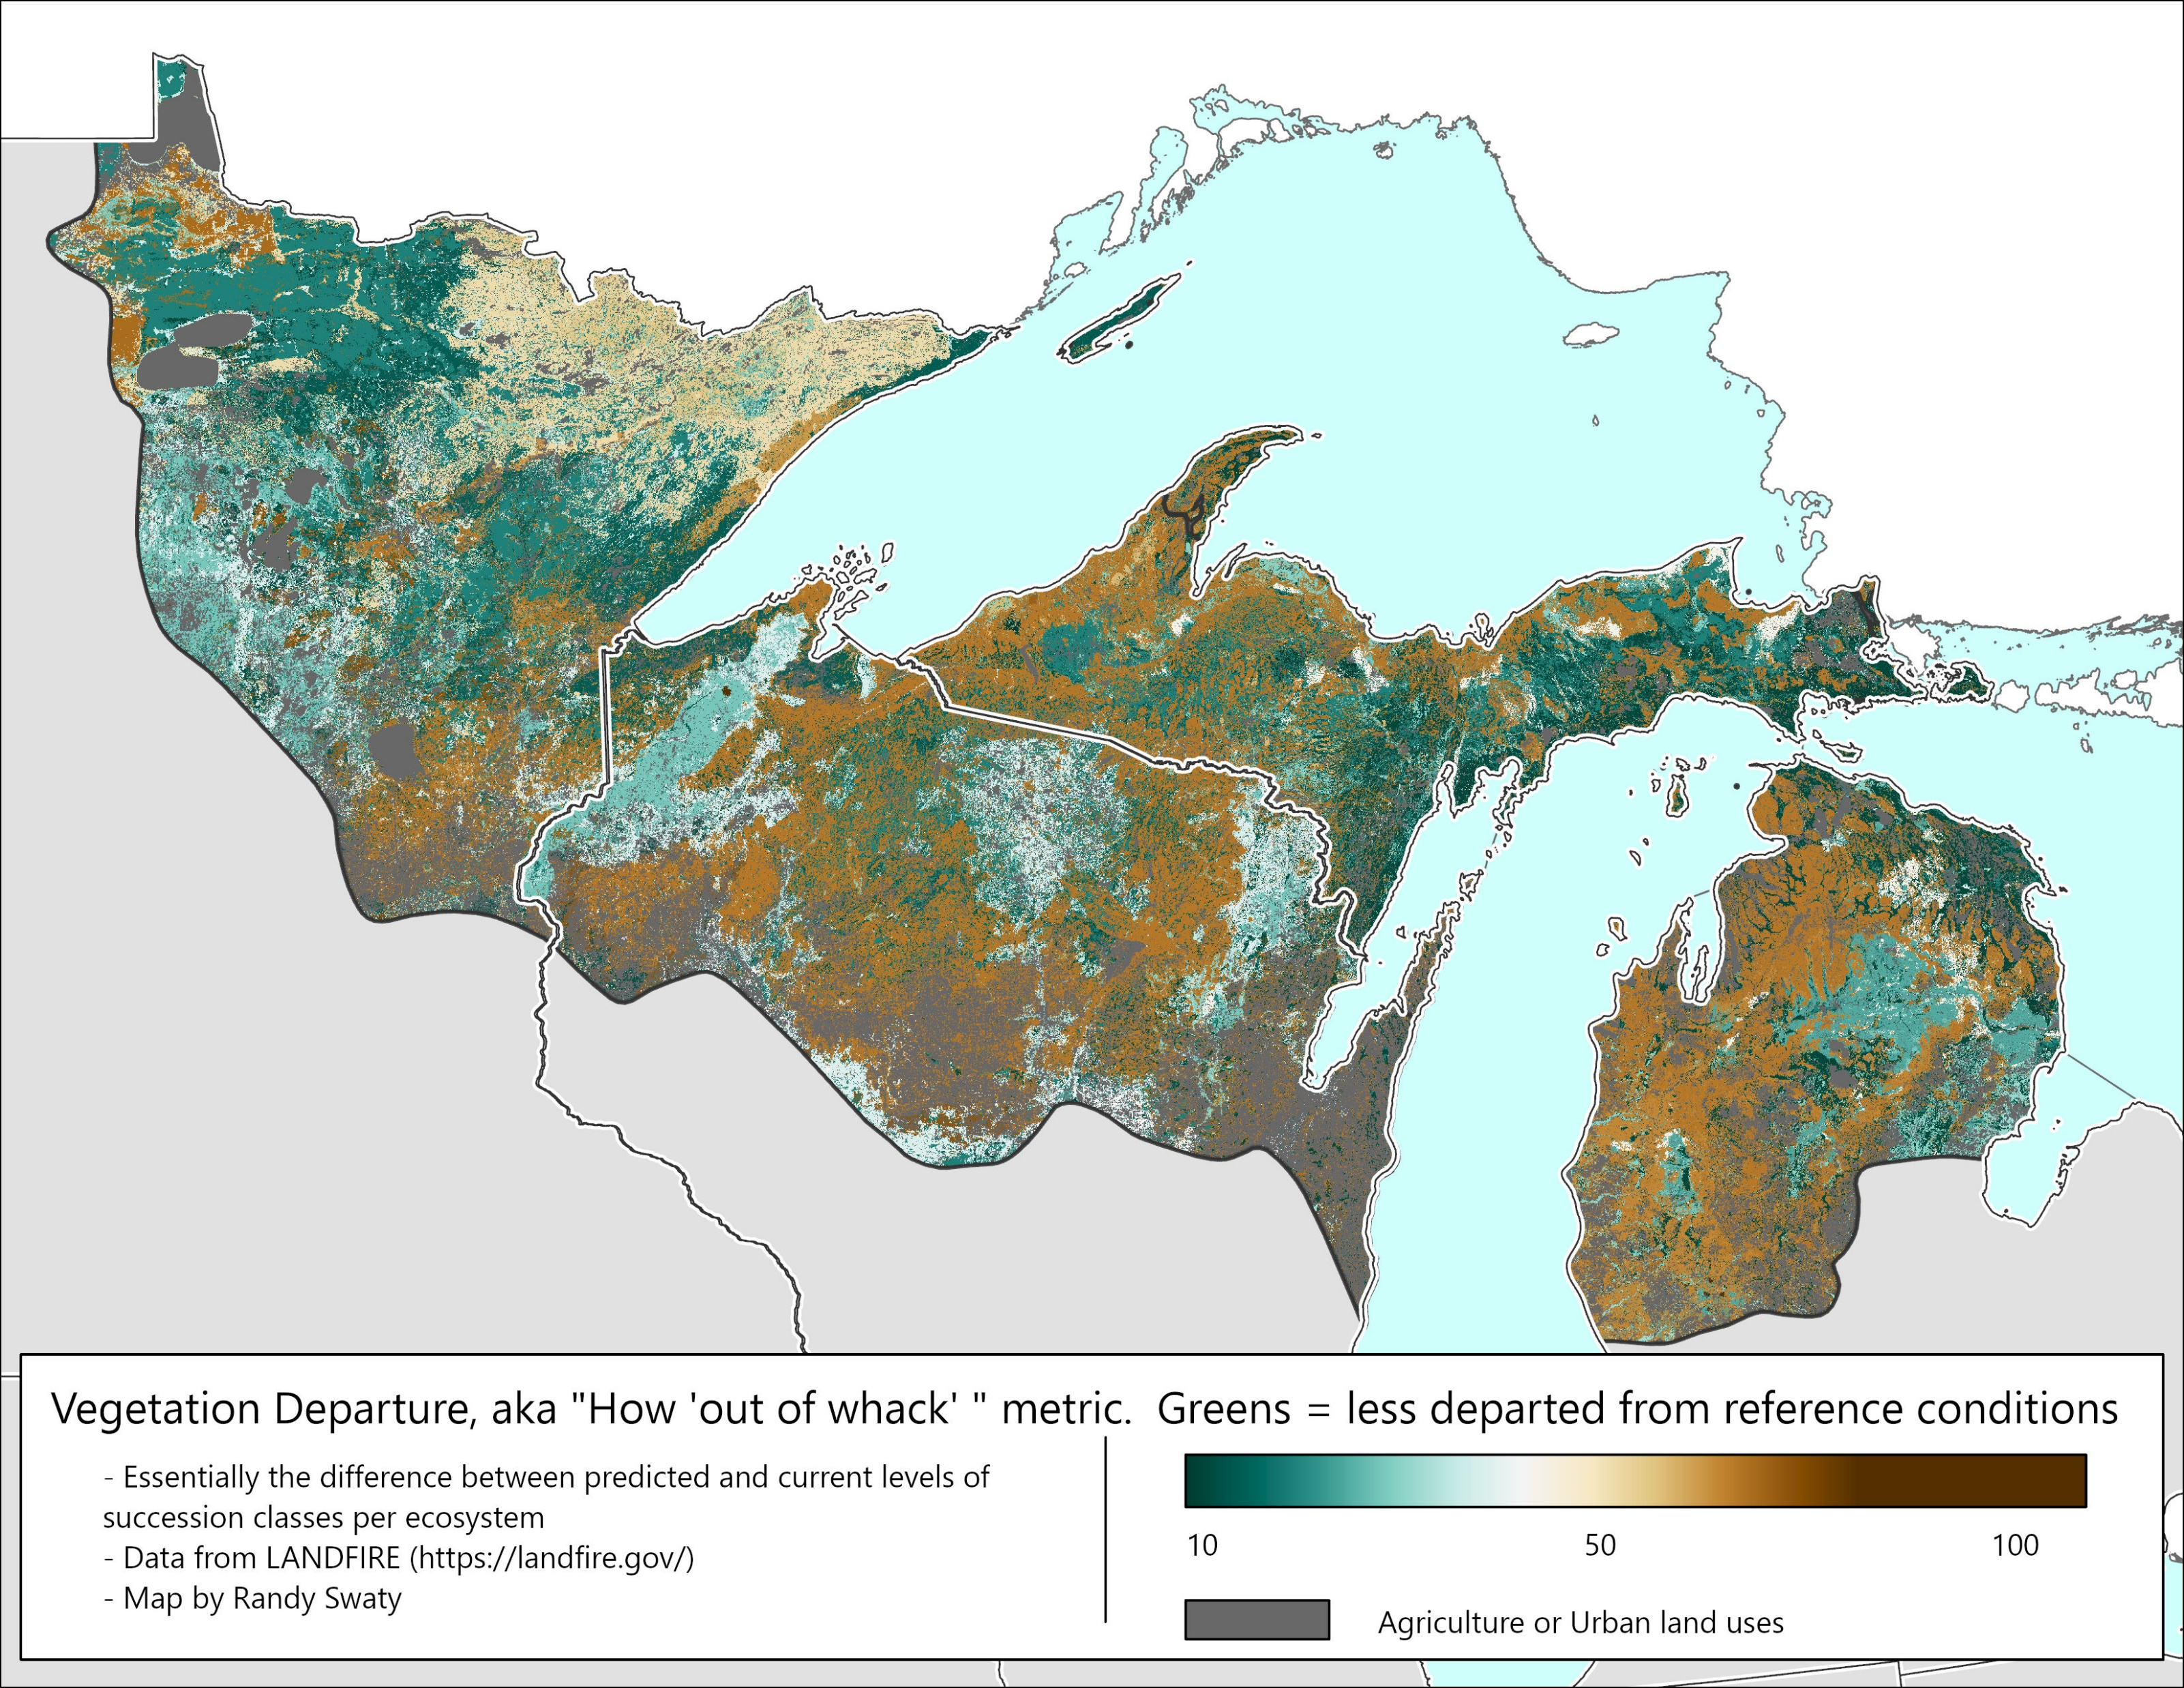
Ecosystem condition
Vegetation Departure data from landfire.gov

Slide 3
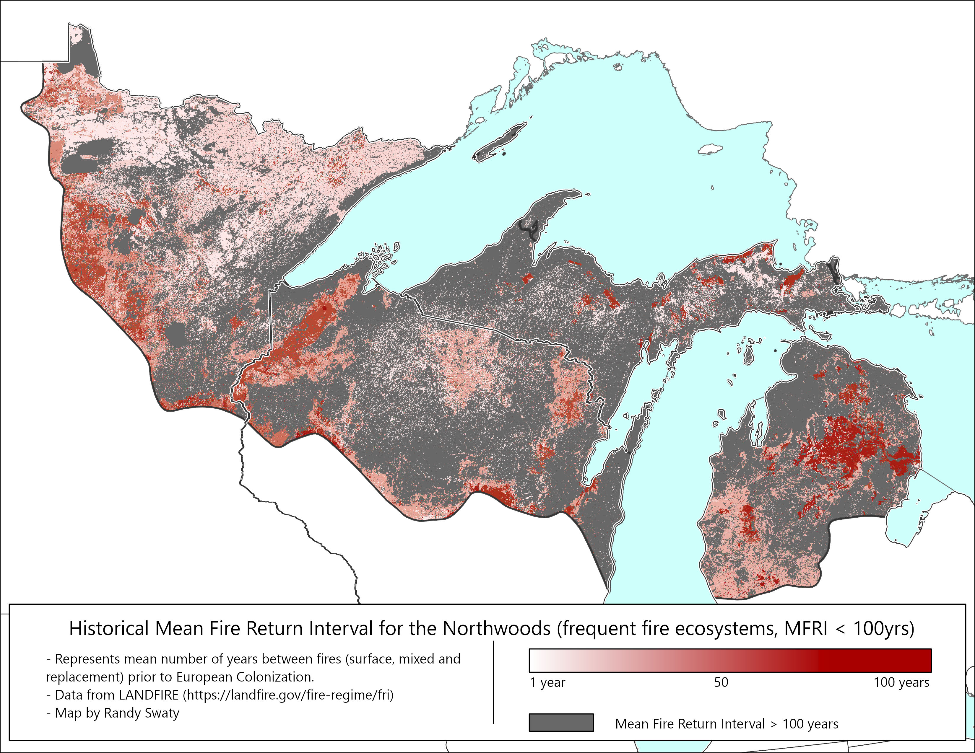
At least 1.5M acres burned every year in MI alone prior to European colonization
Data from LANDFIRE; MI calculation by NMU graduate Becky Lane

Slide 4
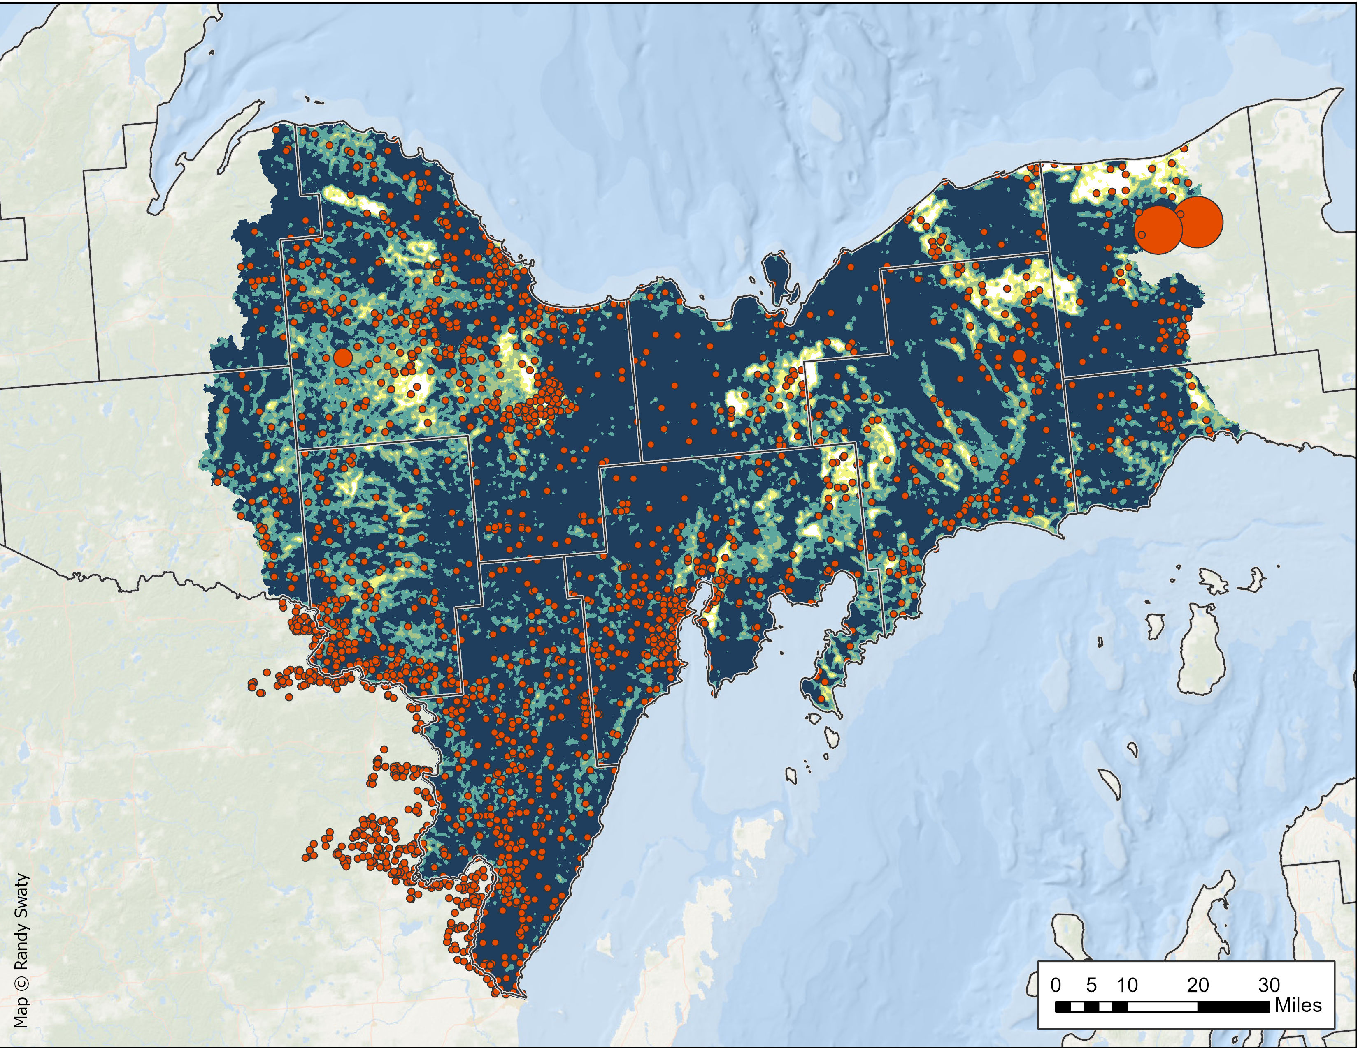
The wildfire threat is real-exhibit A, Wildfire Exposure Risk and recent fire occurrences
Data from LANDFIRE and Short et al (2023), analysis by NMU grad Silas Pickhardt and retired fire behavior analyst Robert Zeil

Slide 5
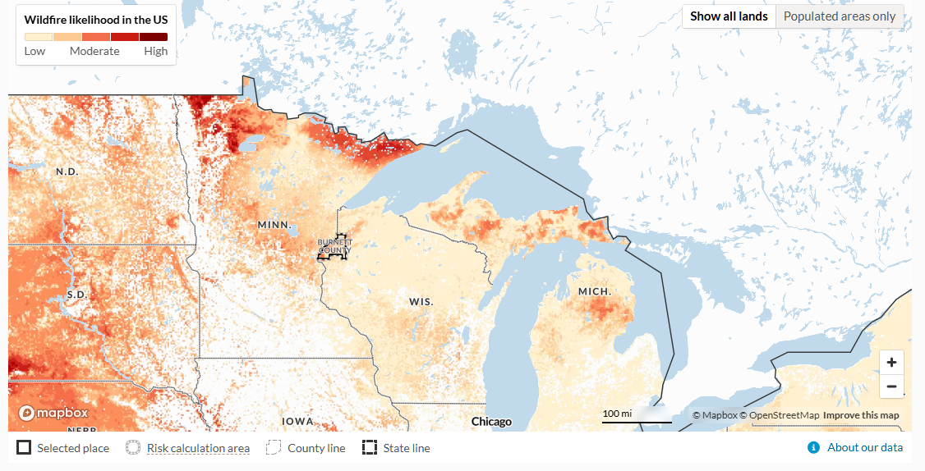
The wildfire threat is real-exhibit B, Wildfire likelihood
From https://wildfirerisk.org/, specifically Wildfire Risk to Communities: Spatial datasets of landscape-wide wildfire risk components for the United States (2nd Edition)

Slide 6
Now what?
Need to figure out what to do where relative to the wildfire threat to communities, both ‘ecological’ and social.
Kim and I have ideas, Tracy has shared thoughts and a vision, BUs have people and brainpower.
Given resources at hand, how can Kim and I best contribute?

